Slide 1
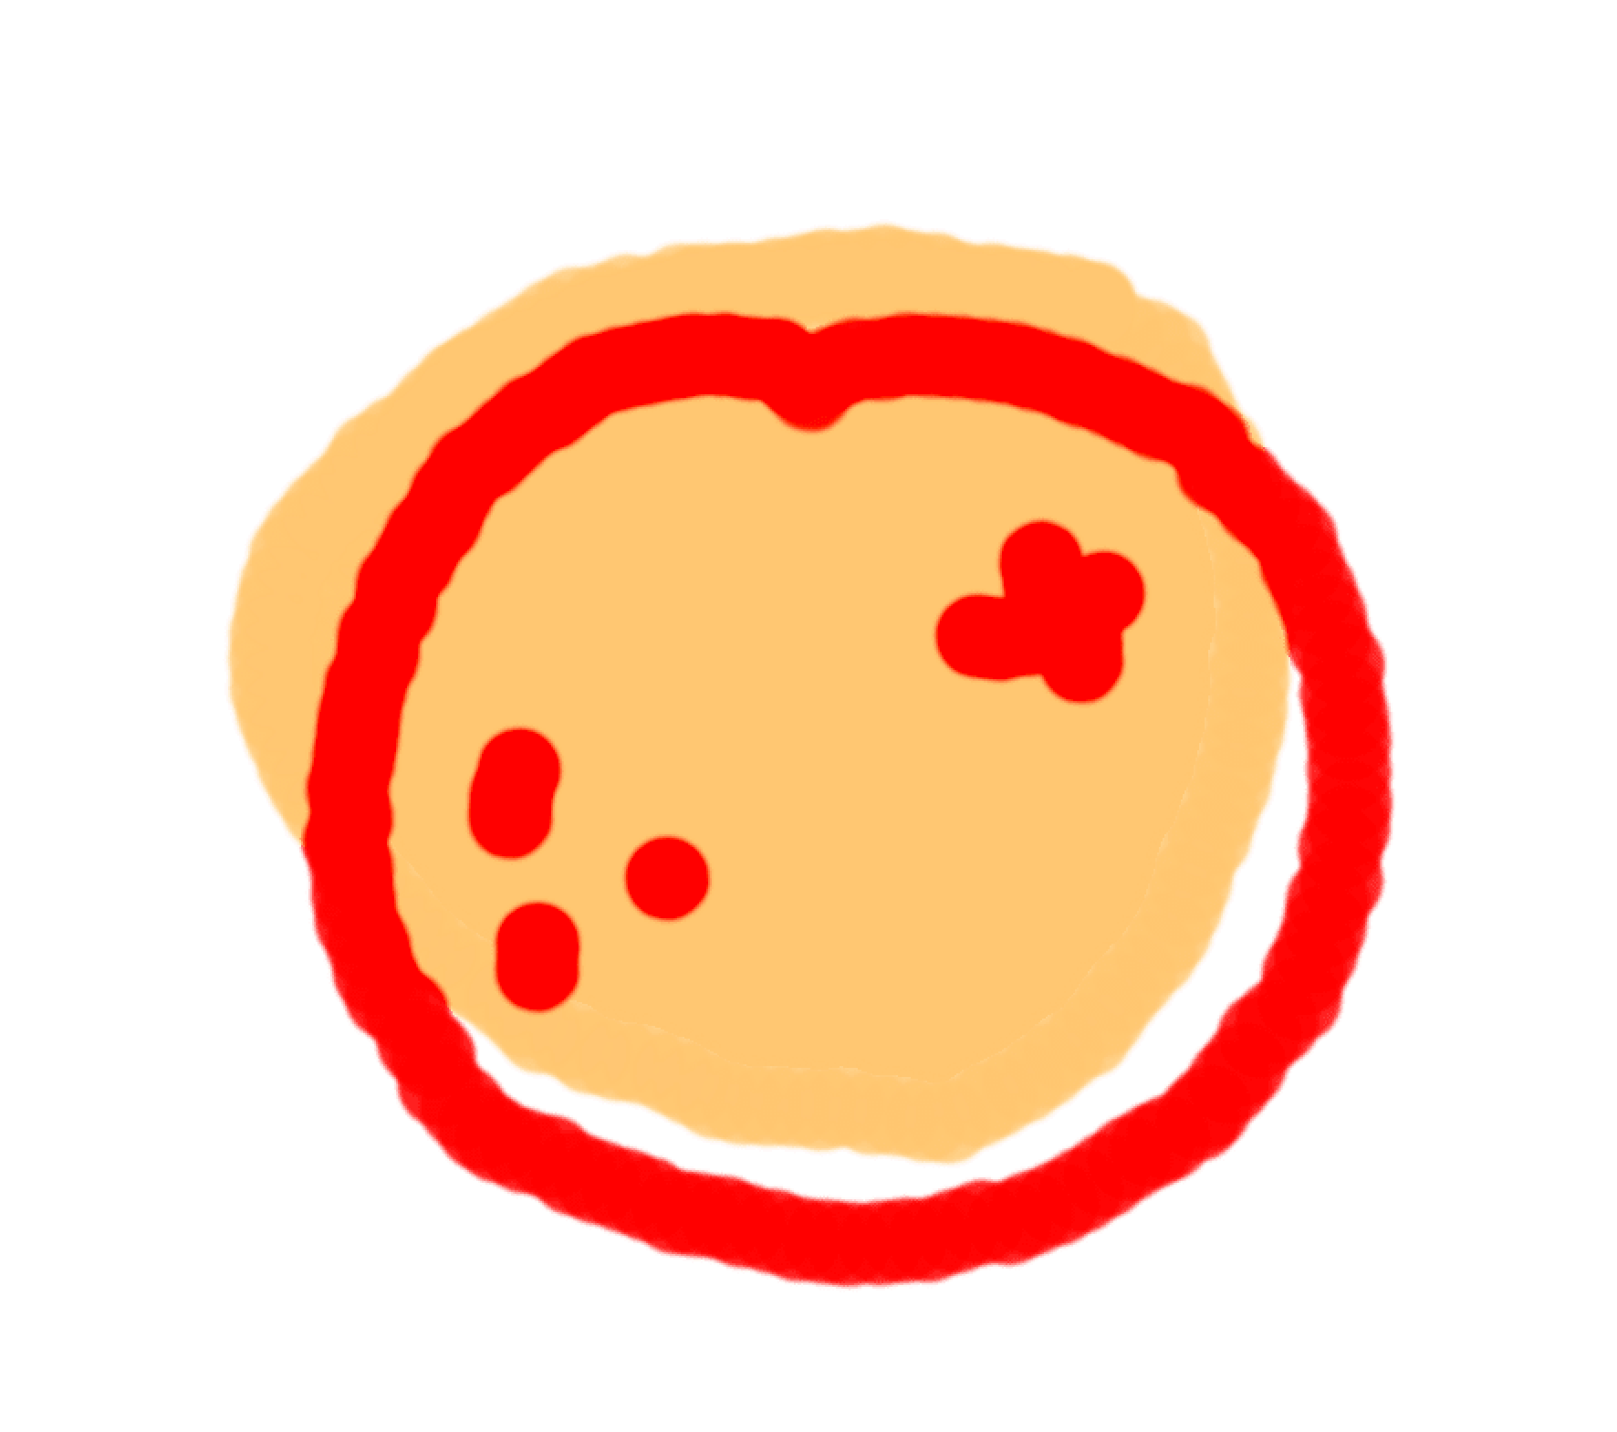
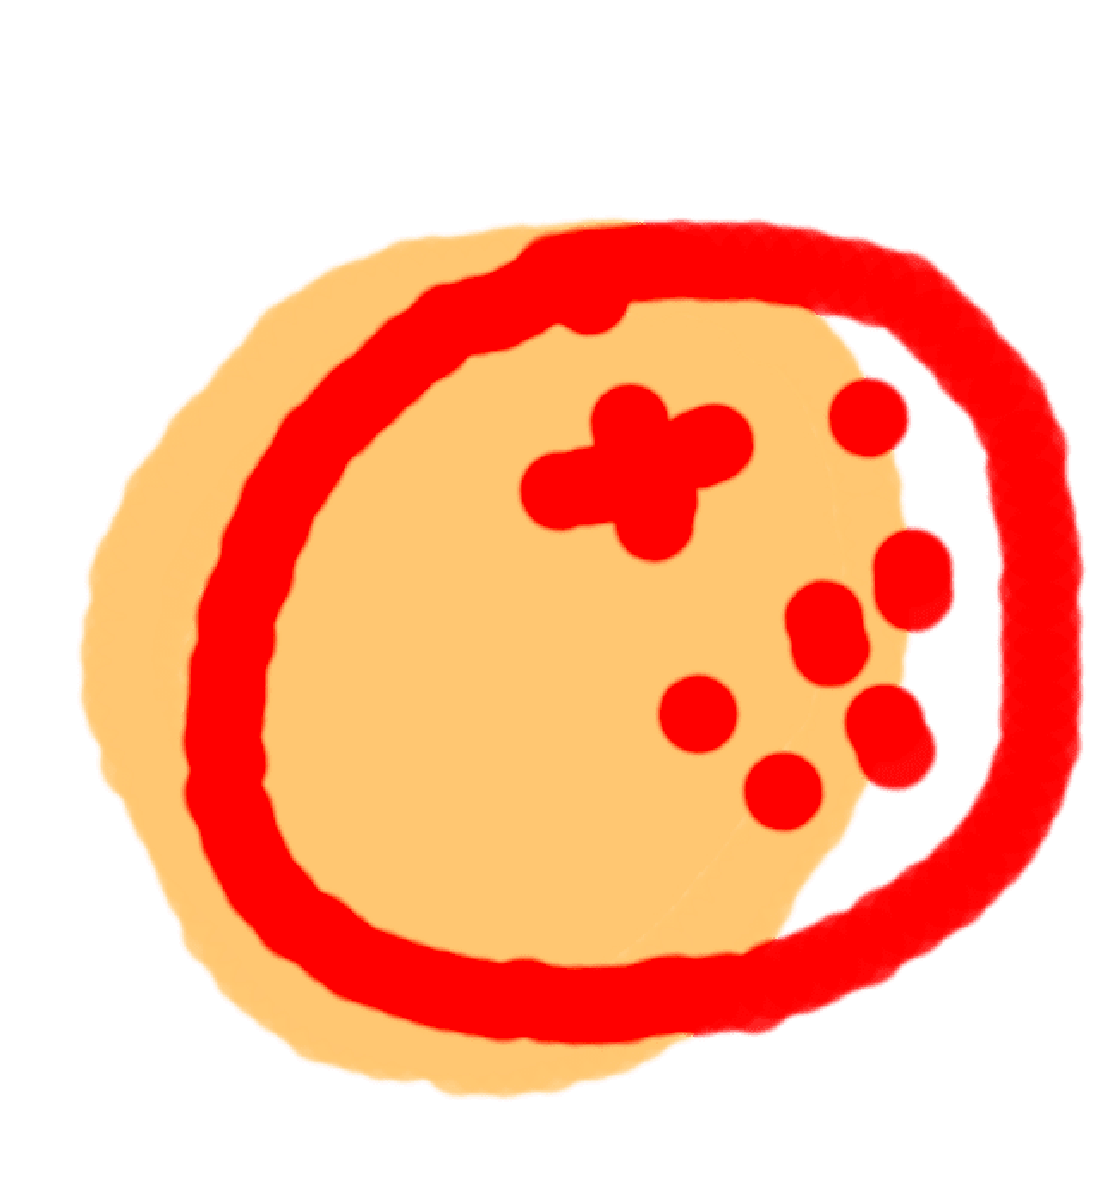
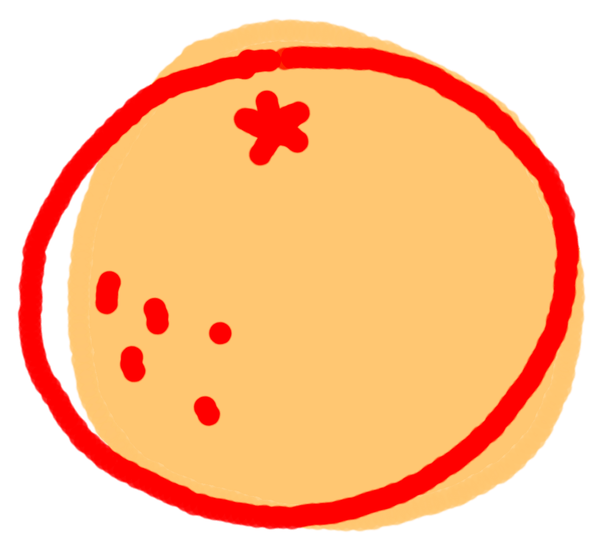


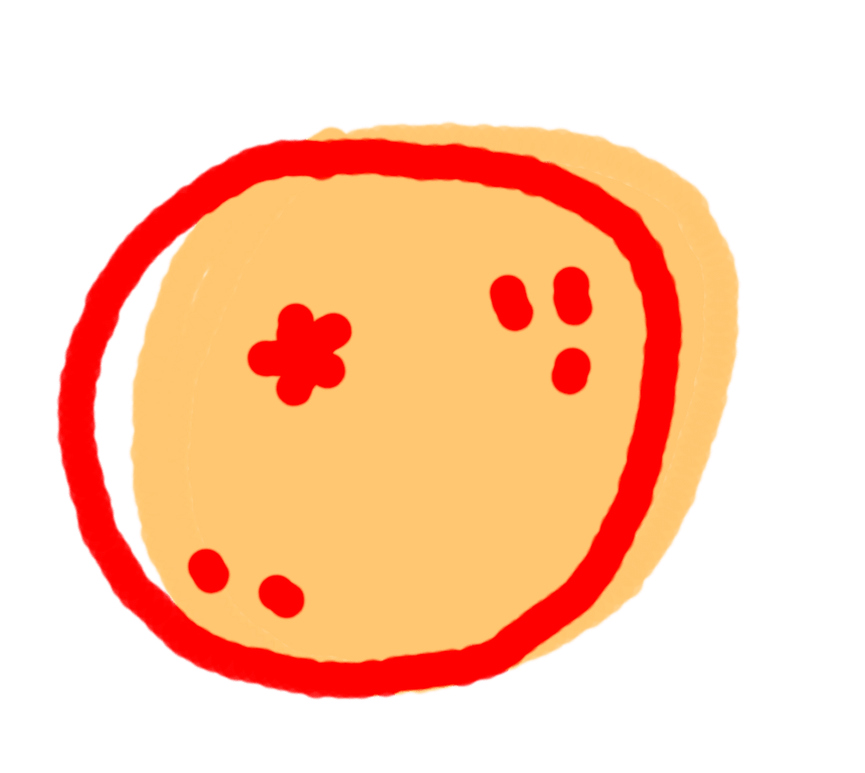



回答你的問題
ANSWERING
YOUR FAQS

Slide 2



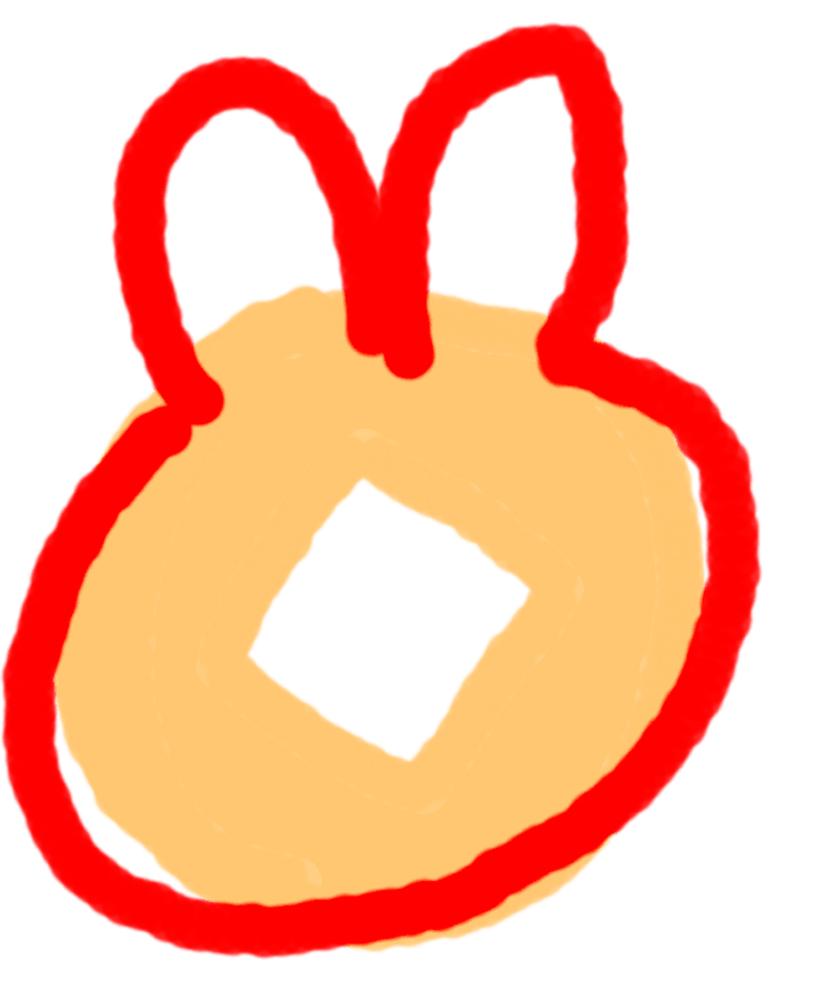

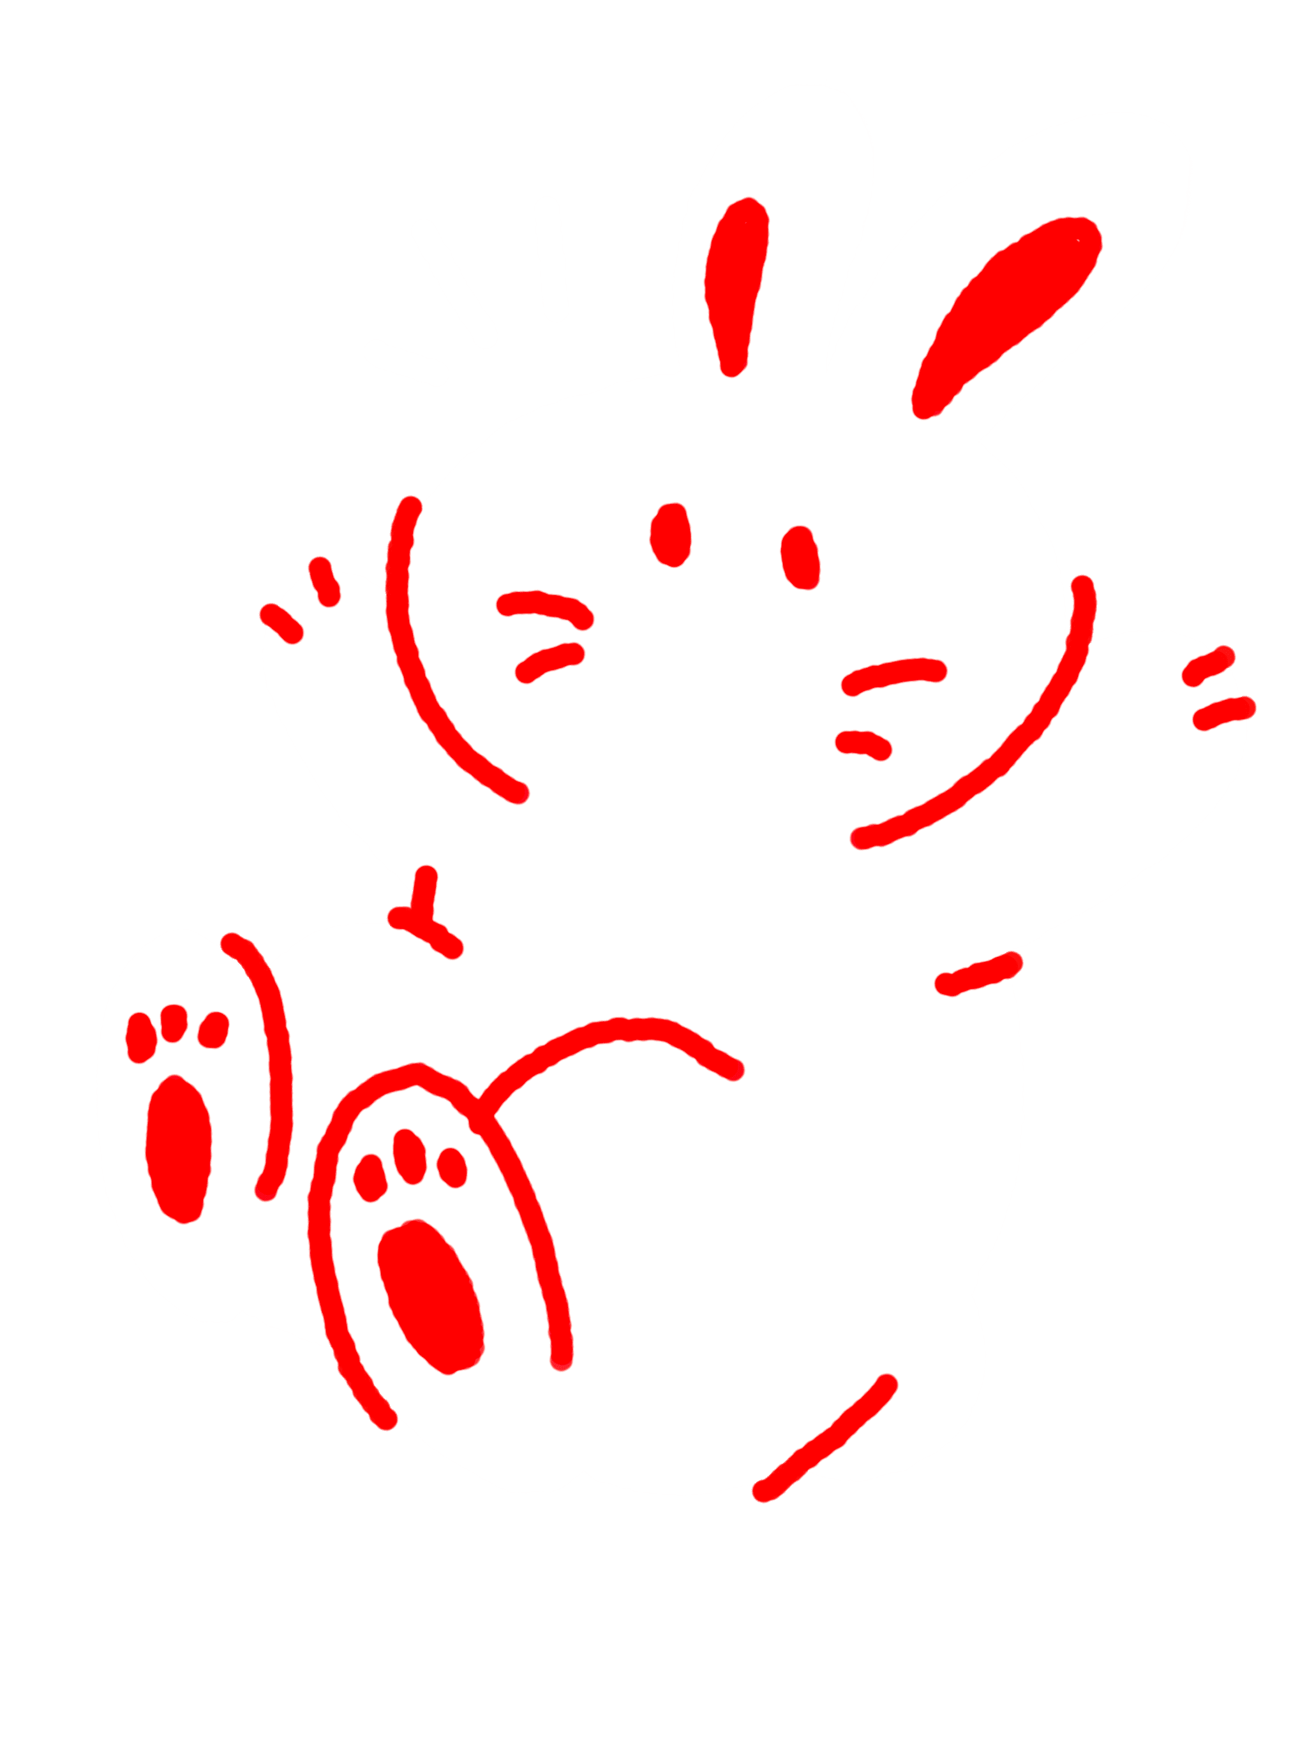




你肥咗喎!
係呀？
YOUVE GAINED WEIGHT！
OH REALLY?

Slide 3







你幾錢人工？
足夠啦。
HOW MUCH DO YOU MAKE?
ENOUGH.

Slide 4
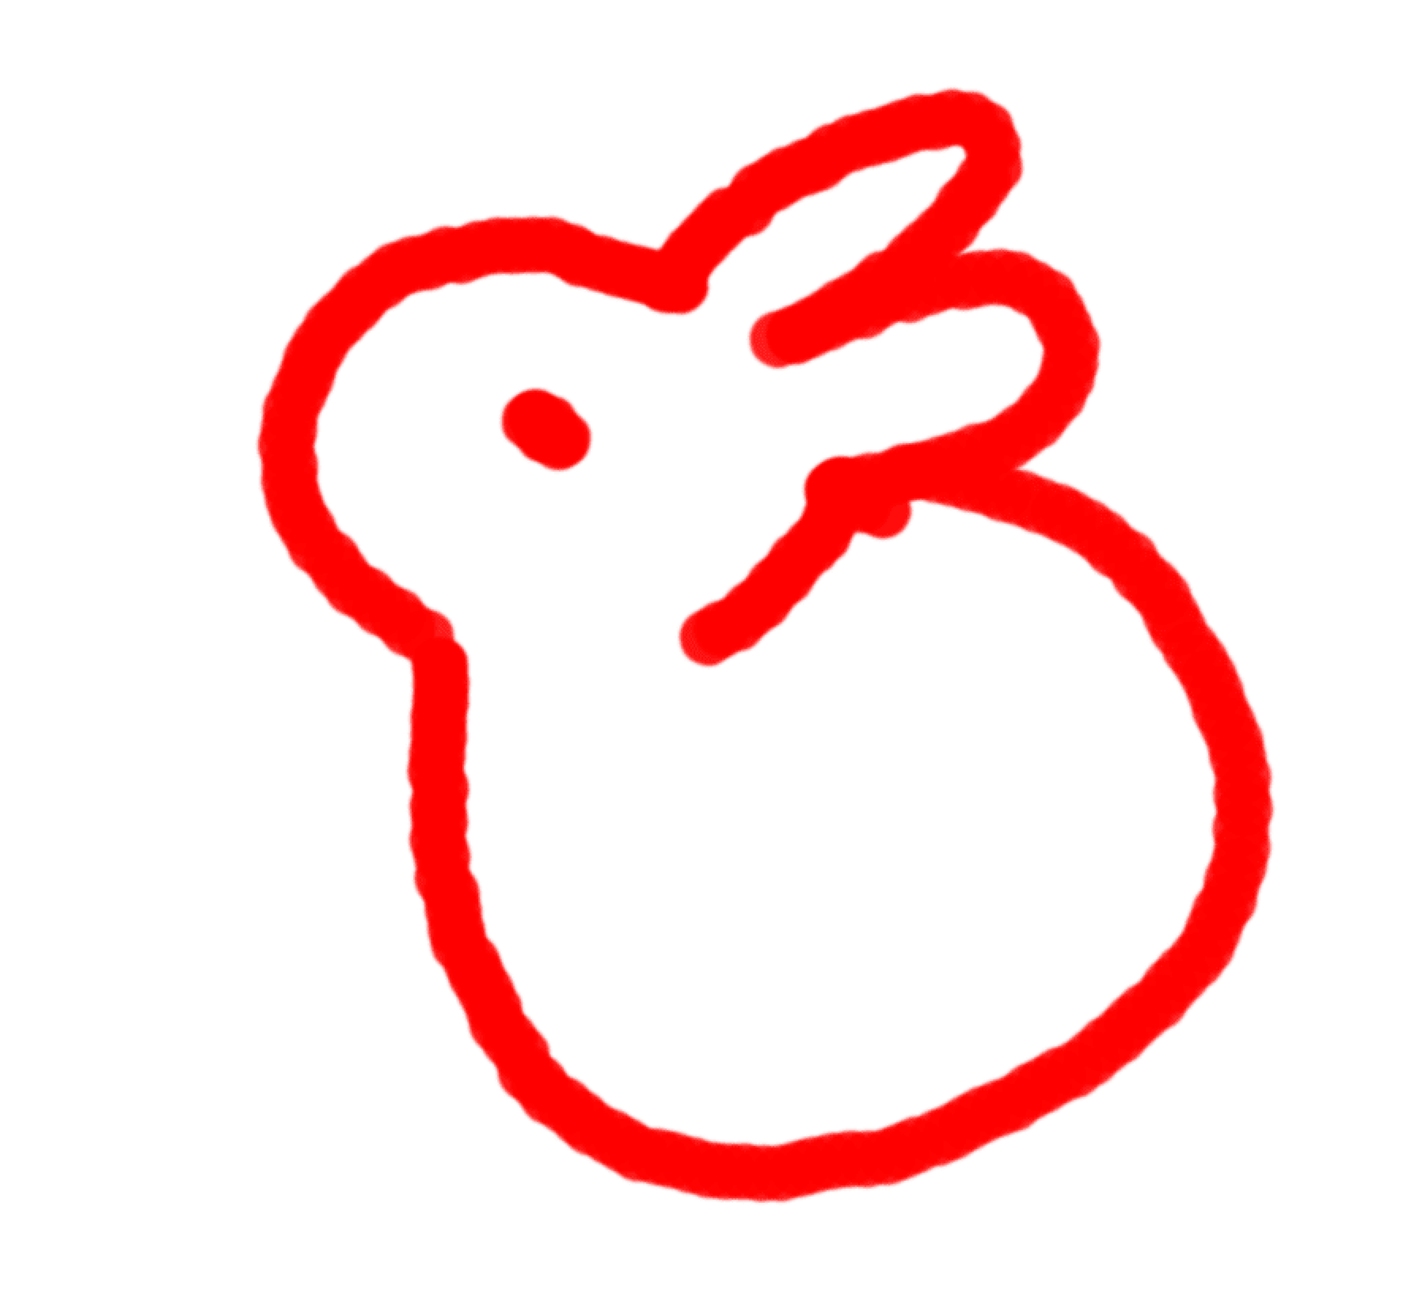
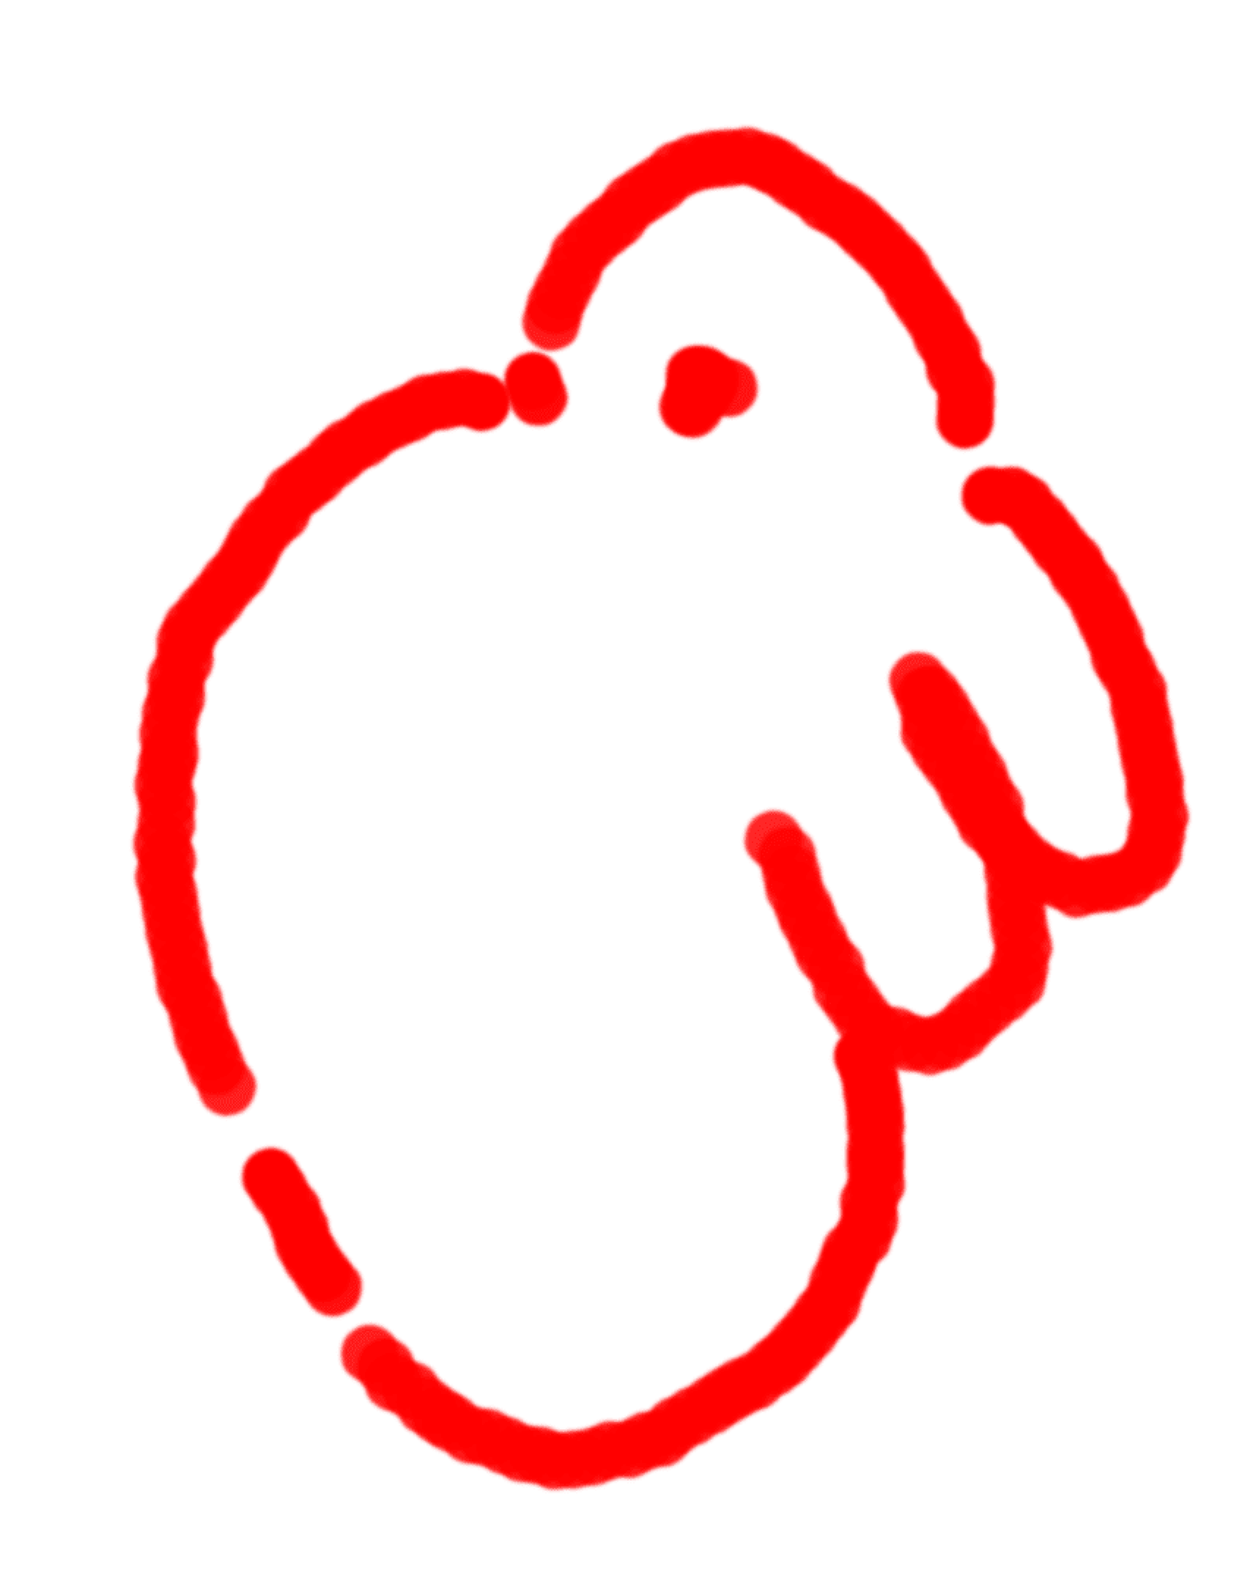
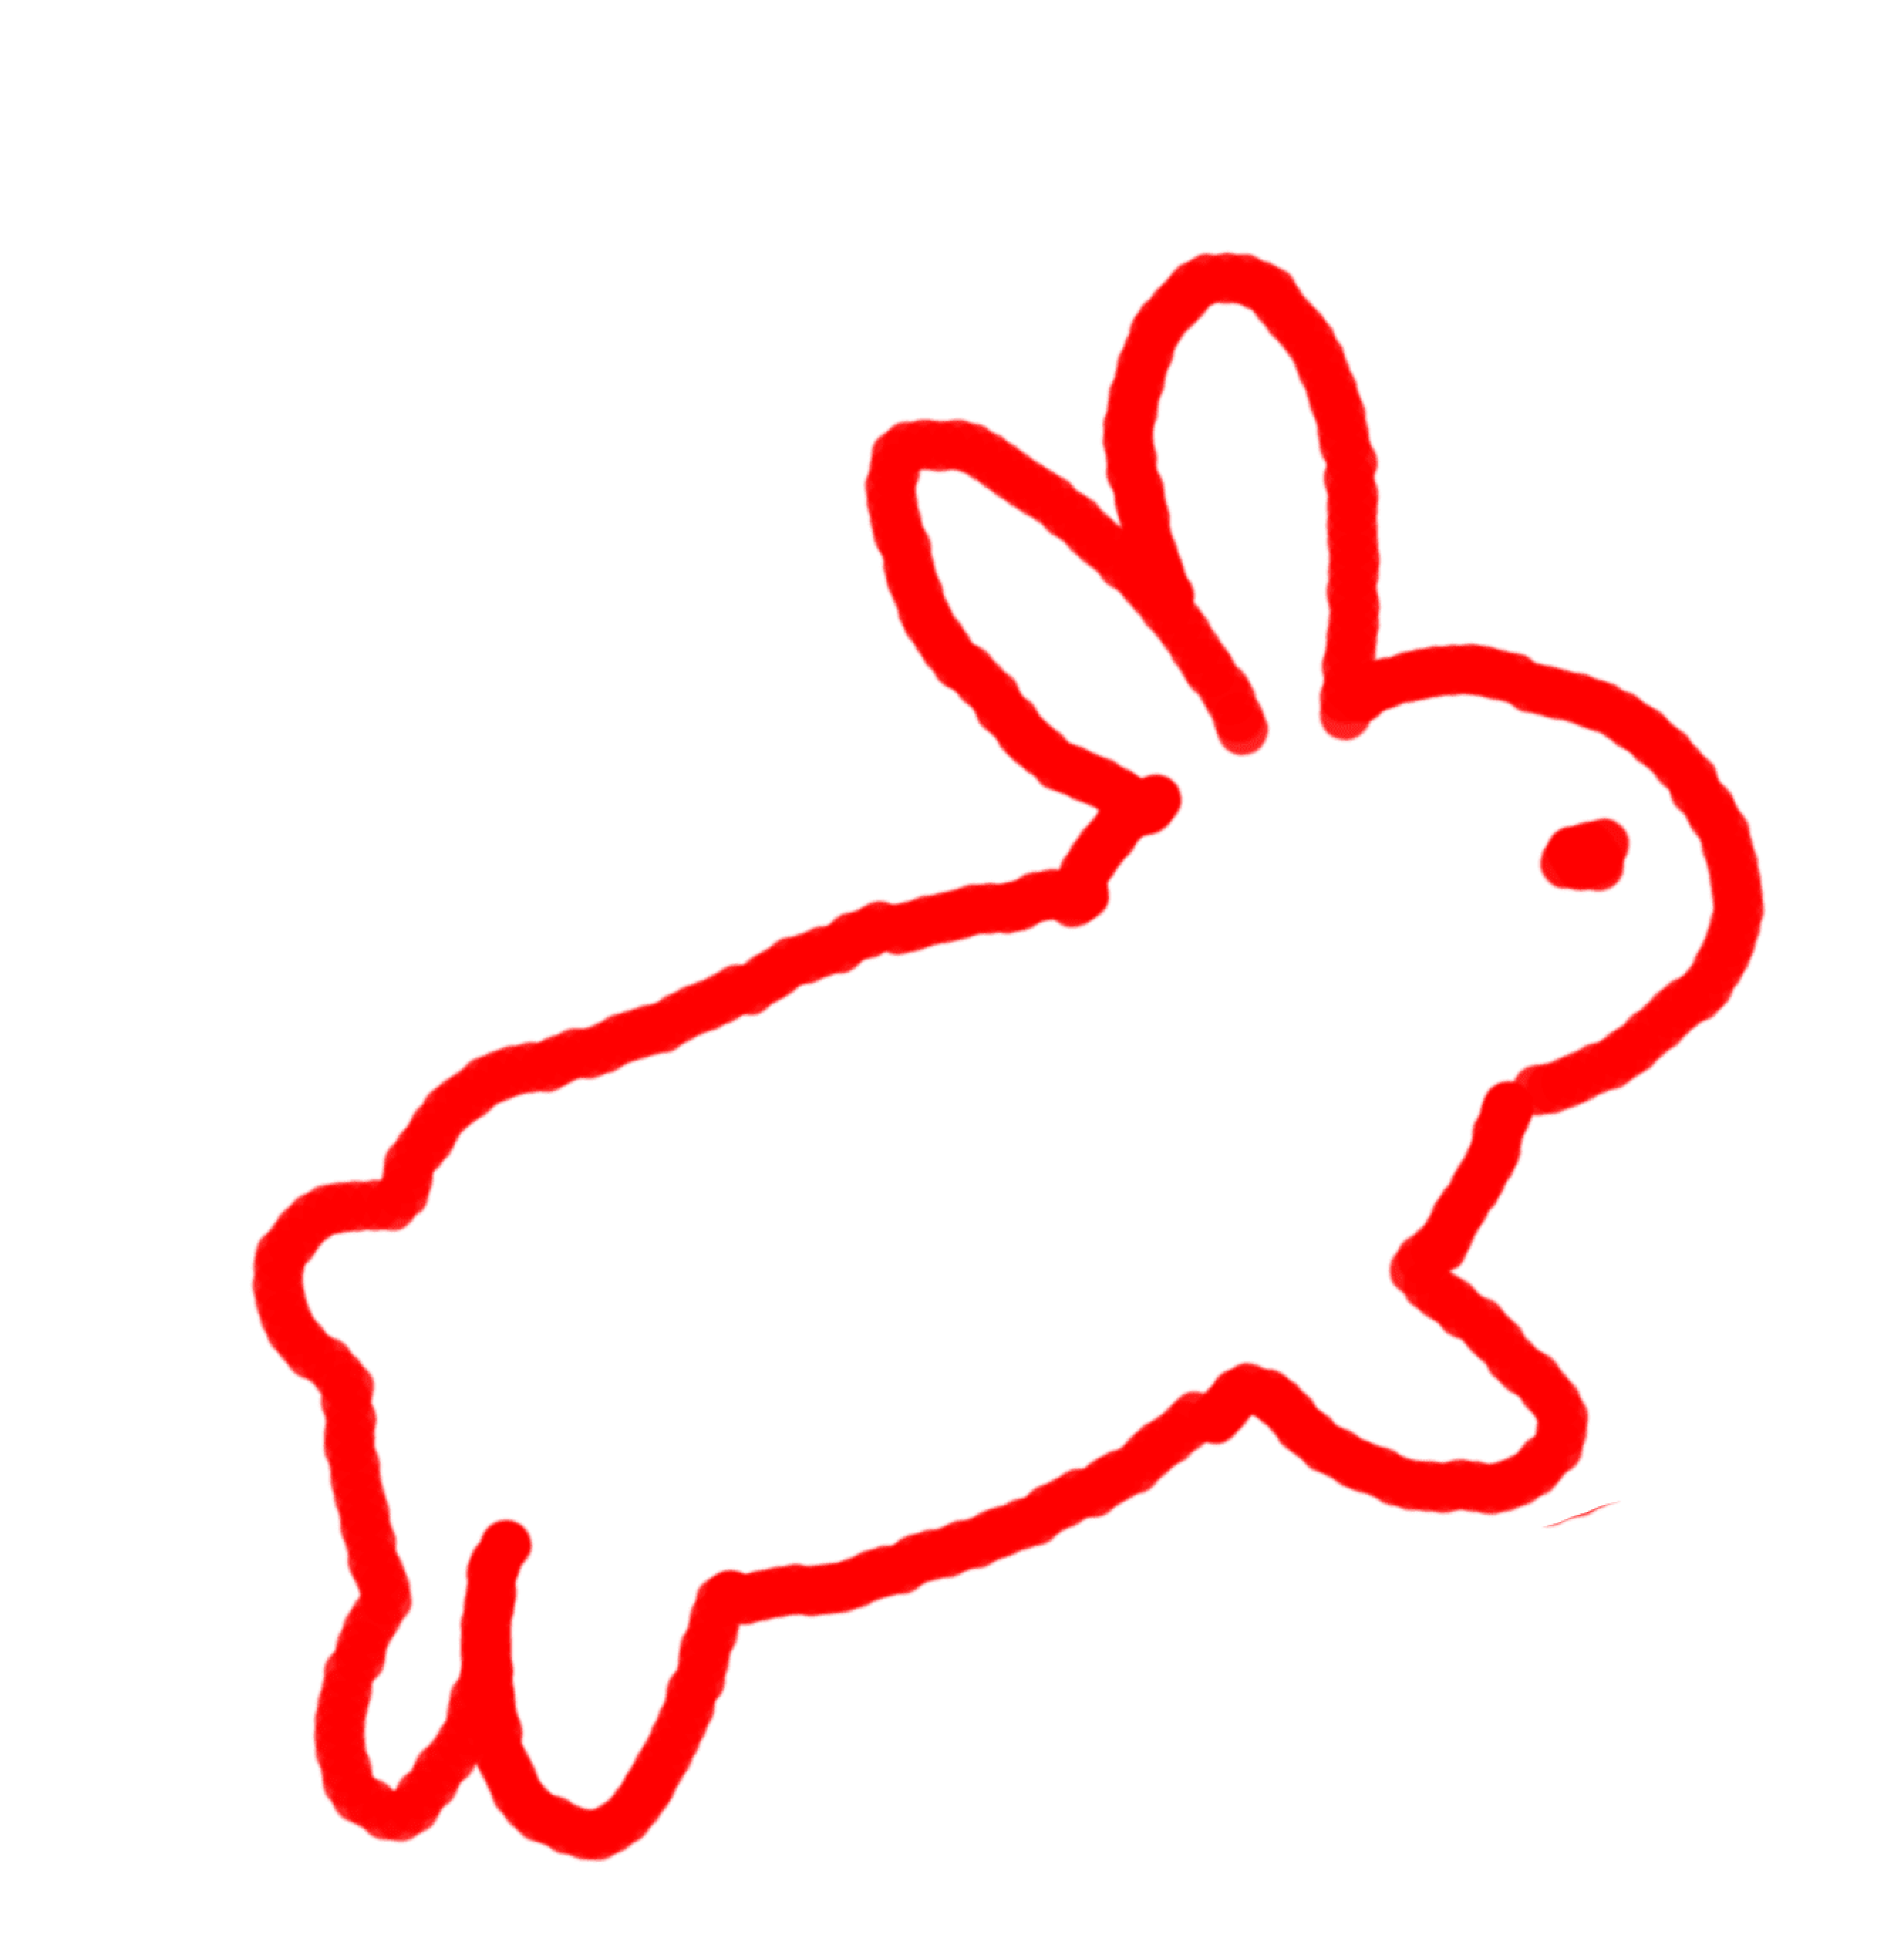

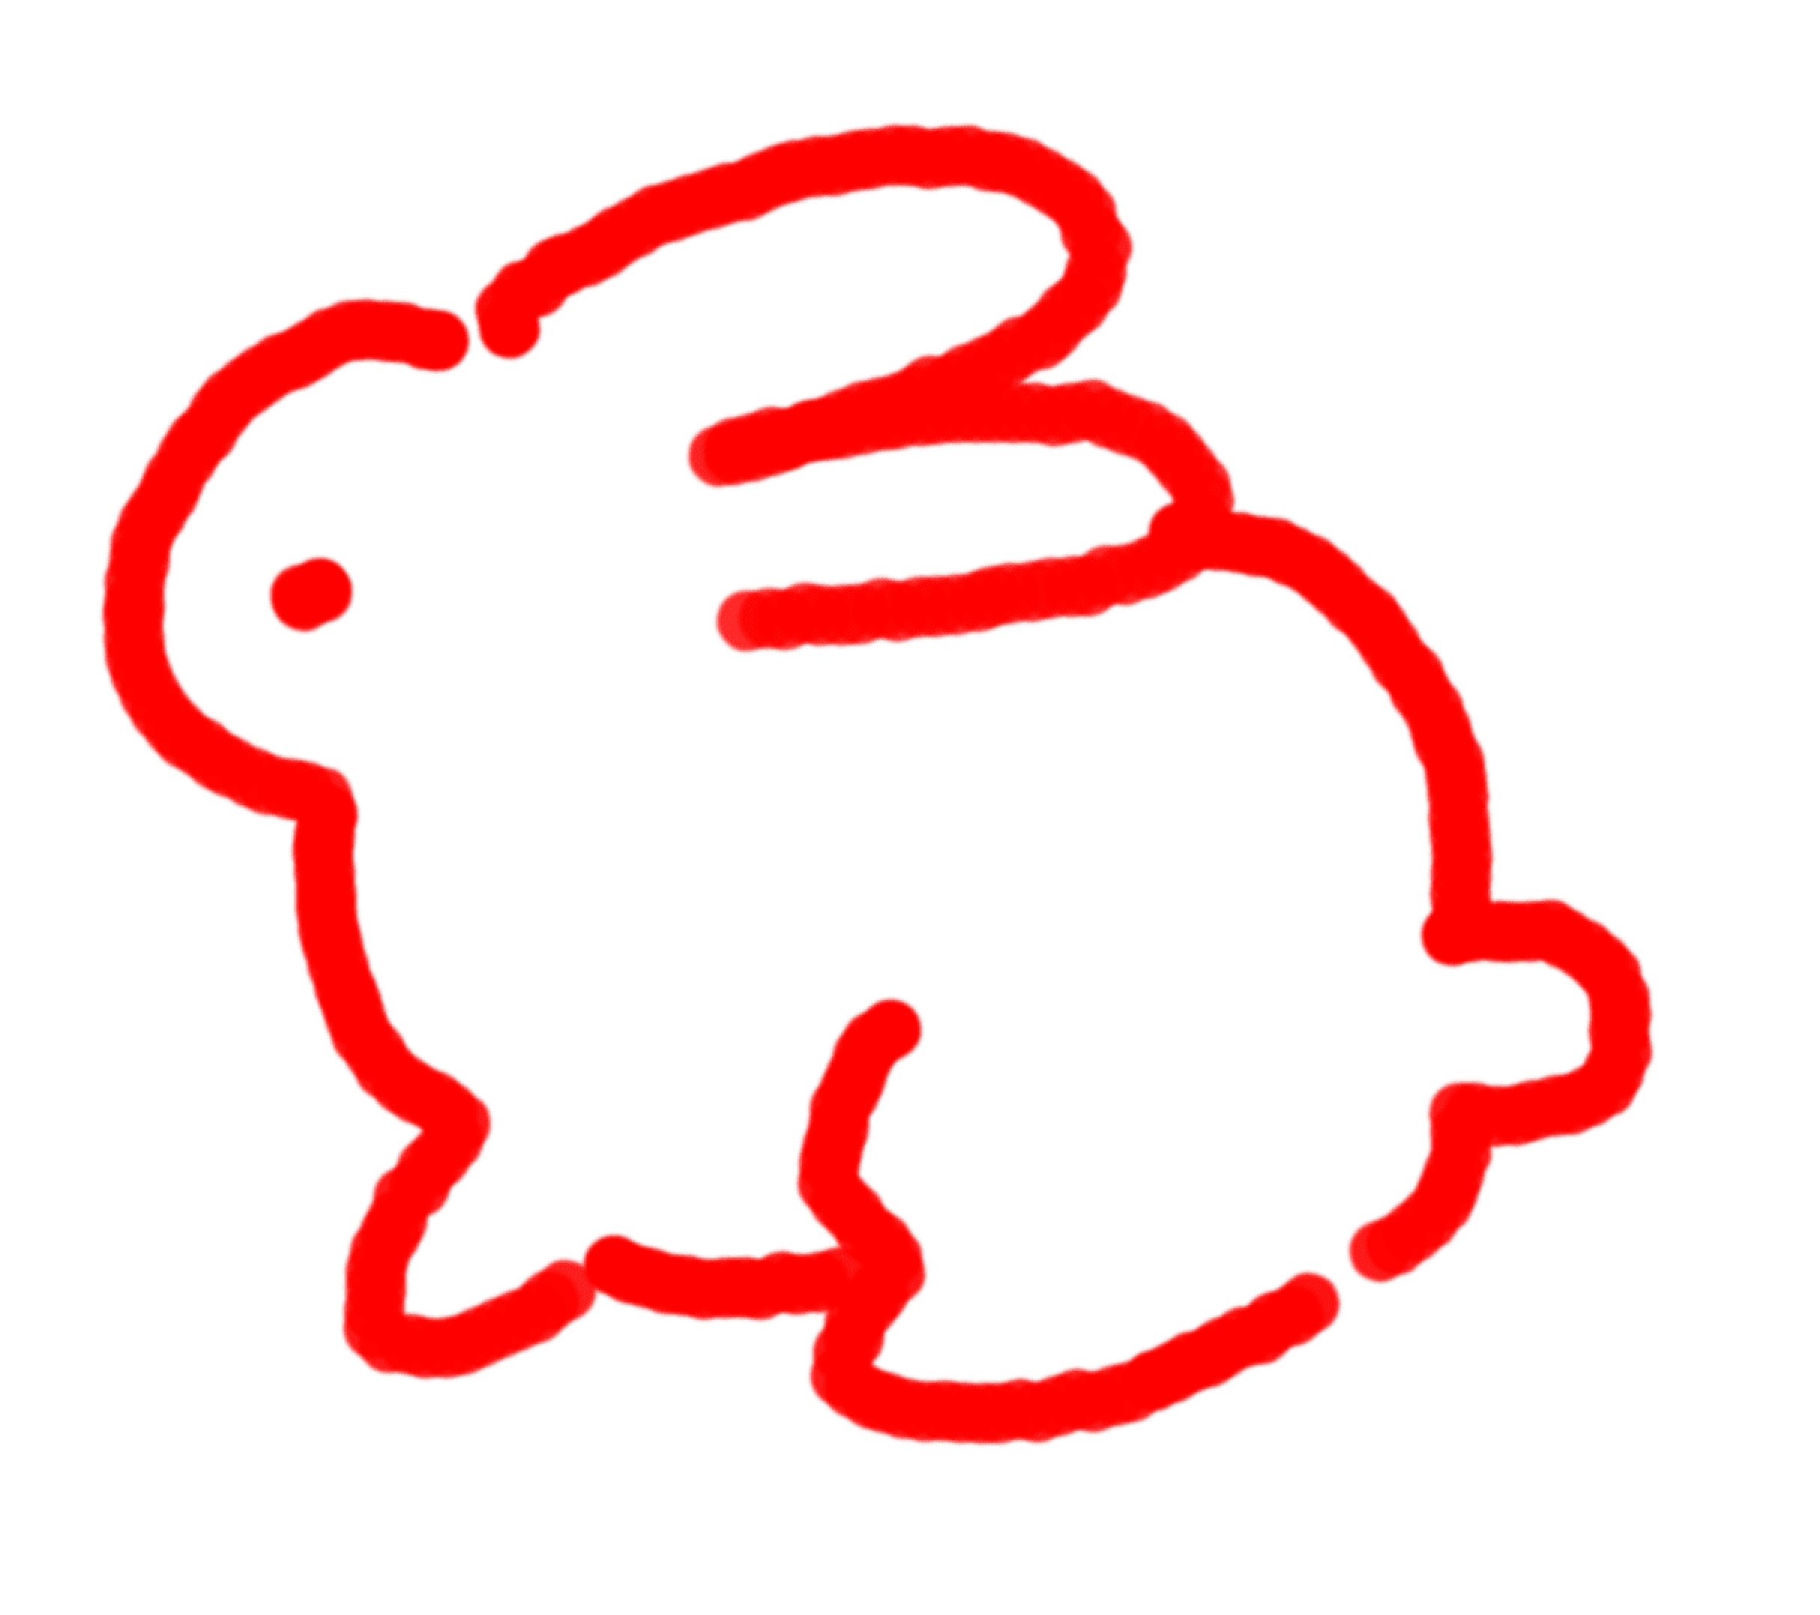

有冇拍拖？
冇。
ARE YOU DATING?
NO.

Slide 5
唔知啊，有嗰陣就通知你
幾時結婚/生仔？
WHEN WILL YOU GET MARRIED/HAVE KIDS?
I DONT KNOW, ILL LET YOU KNOW WHEN I DO

